Slide 1
Activities Unlimited
History Club
A Review of Four Historically Significant
United States States Presidential Elections
July 25, 2023

Slide 2
United States Presidential Elections
I encourage you to ask questions at any time
  Raise your hand, don’t shout out
  I may not call on you immediately, but I will when the time is appropriate
I will try my best to answer your questions
However, since I am not a scholar, I may not know the answer to a particular question

Slide 3
United States Presidential Elections
Presidential Elections
  Some memorable, some infamous
  Historians have reviewed archival documents for judgments on these elections
    Three in our lifetime
      1948 Truman vs Dewey
      1960 Kennedy vs Nixon
      2000 Bush vs Gore
    One which historians consider the most corrupt
      1876 Hayes vs Tilden

Slide 4
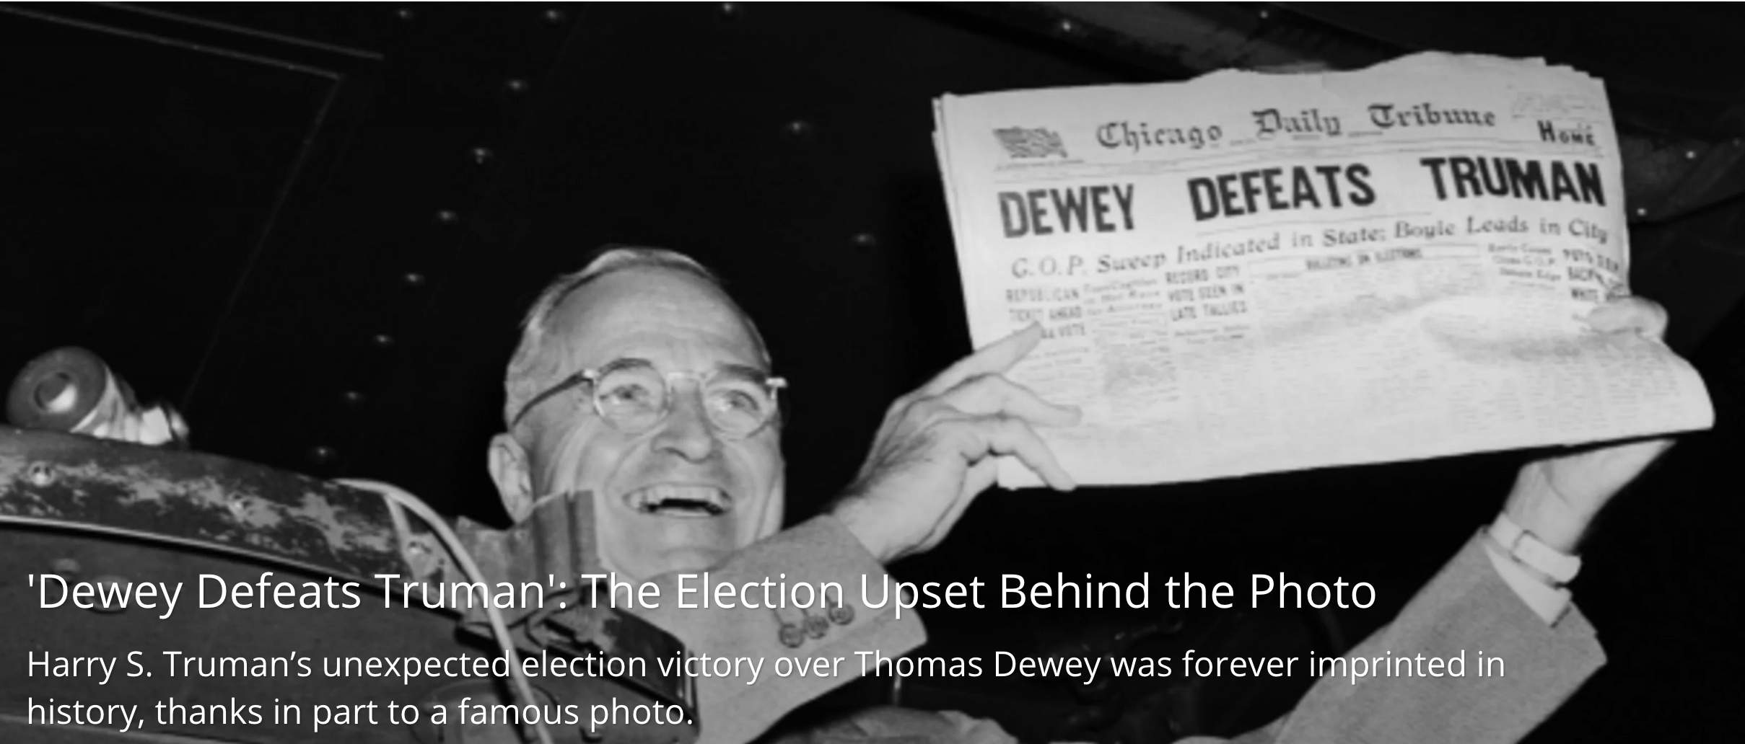
United States Presidential Elections
1948 Truman versus Dewey*

Slide 5
United States Presidential Elections
Truman vs Dewey*
  Truman’s approval rating was seen as a severe handicap against Dewey’s popularity*
    In April 1948, Truman’s approval rating was 38% the low point of 1948
  Dewey ran an uninspiring, risk-averse campaign
  Heading into election day, November 2, 1948, Thomas Dewey was considered the next U.S. president by many newspapers, magazines, and political pundits.

Slide 6
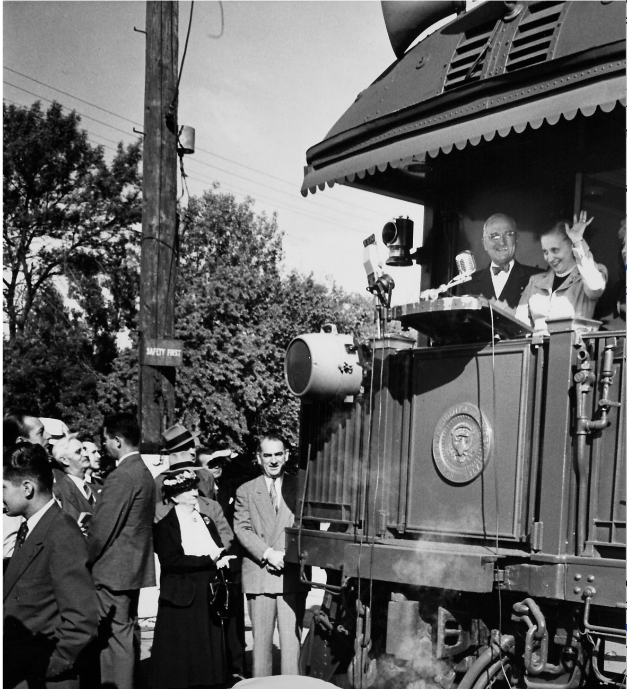
1948 Election – Truman vs Dewey

Slide 7
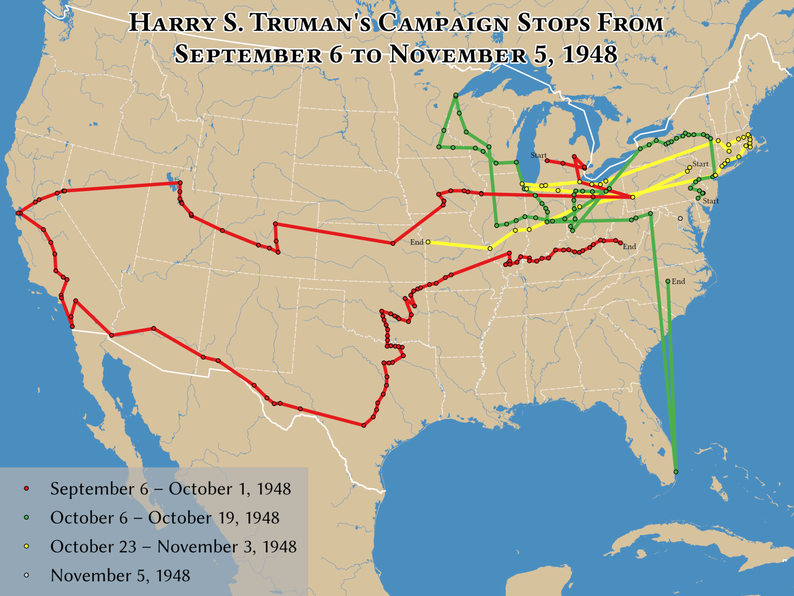
United States Presidential Elections
Harry Truman’s whistle stop tour

Slide 8
United States Presidential Elections
Truman vs Dewey
  Election results
    Truman 303 Electoral votes, Dewey 189
    Truman won over 2 million more popular votes than Dewey
    Truman is ranked among the top ten presidents by both conservative and liberal scholars

Slide 9
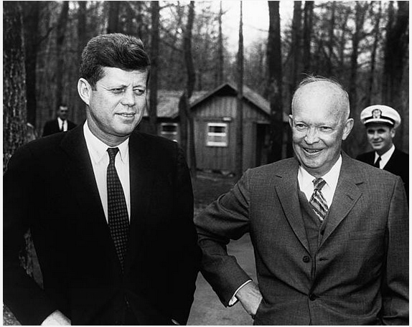
United States Presidential Elections
1960 Kennedy versus Nixon*

Slide 10
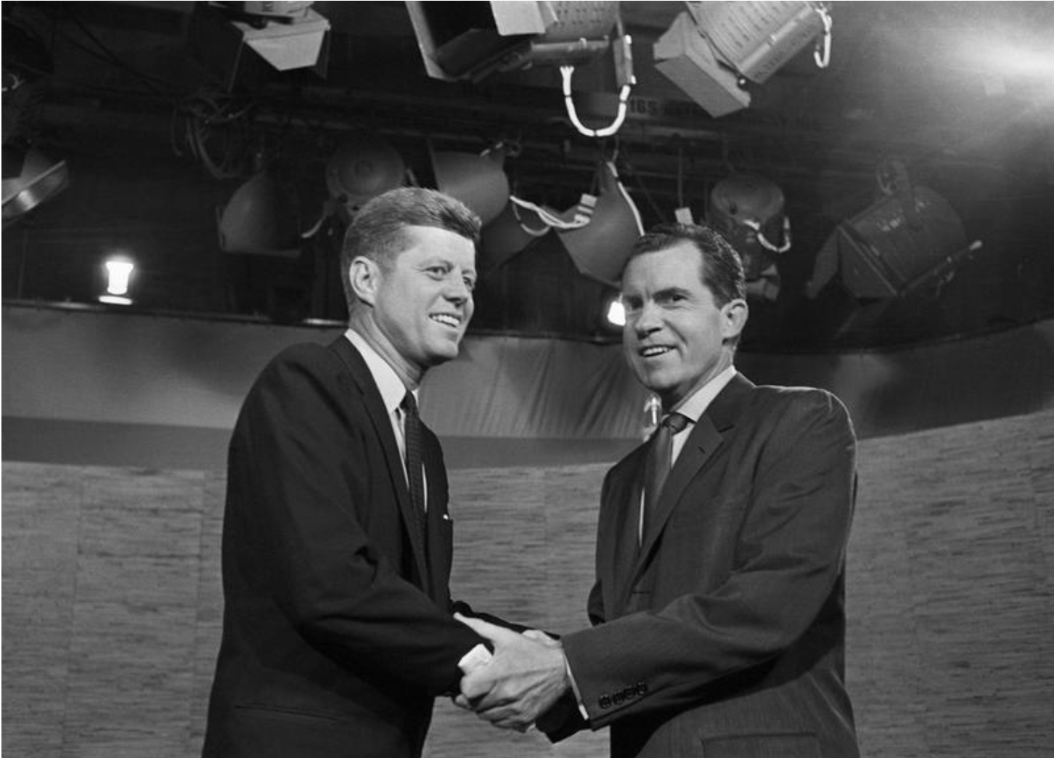
United States Presidential Elections
1960 Kennedy versus Nixon*

Slide 11
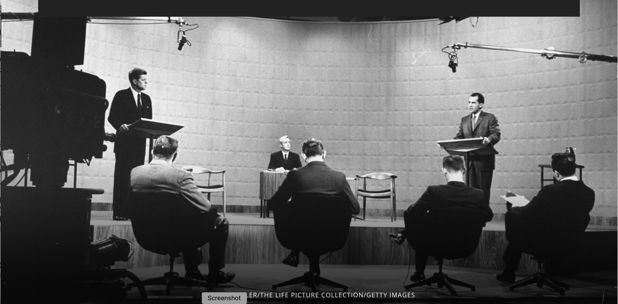
United States Presidential Elections
1960 Kennedy versus Nixon*

Slide 12
I960 Election – Kennedy vs Nixon
Candidate | Party | Electoral Votes | Popular Votes
John F. Kennedy | Democratic | 303 | 34,227,096
Richard M. Nixon | Republican | 219 | 34,107,646
Harry F. Byrd | Democratic | 15 | 116,248

Slide 13
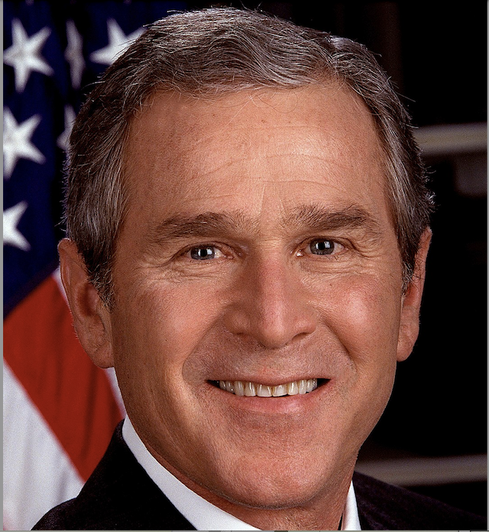
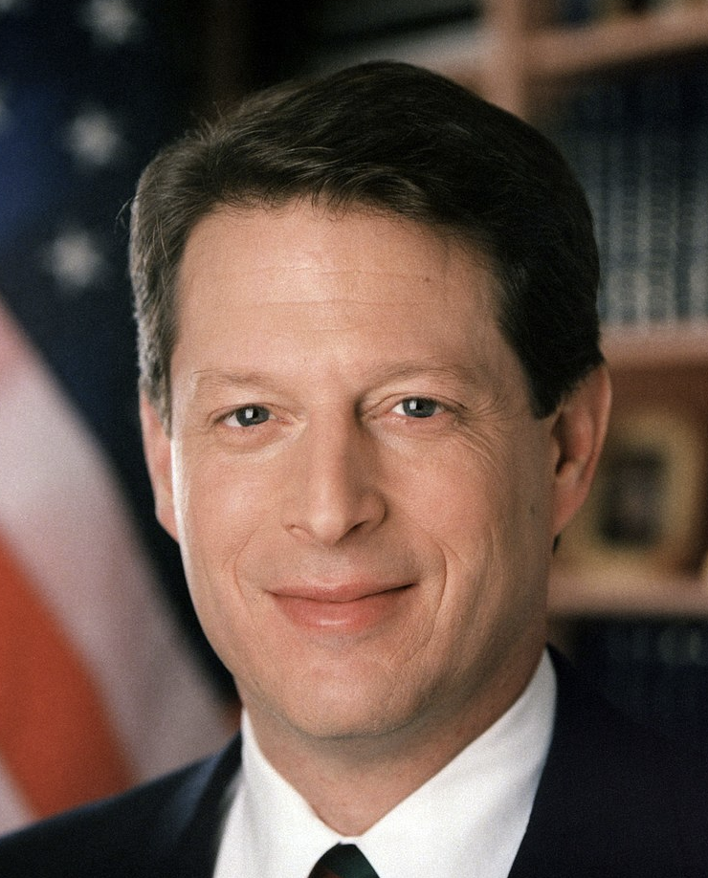
2000 Election – Bush vs Gore

Slide 14
2000 Election – Bush vs Gore
No clear winner on election night November 7, 2000 when the polling places closed
    Three states had not declared a winner
      Florida (25), Oregon (7), and New Mexico (5)
      Gore eventually won Oregon and New Mexico
    Whoever won Florida’s 25 electoral votes was the next president of the United States
  The term chads became the hot item of the moment

Slide 15
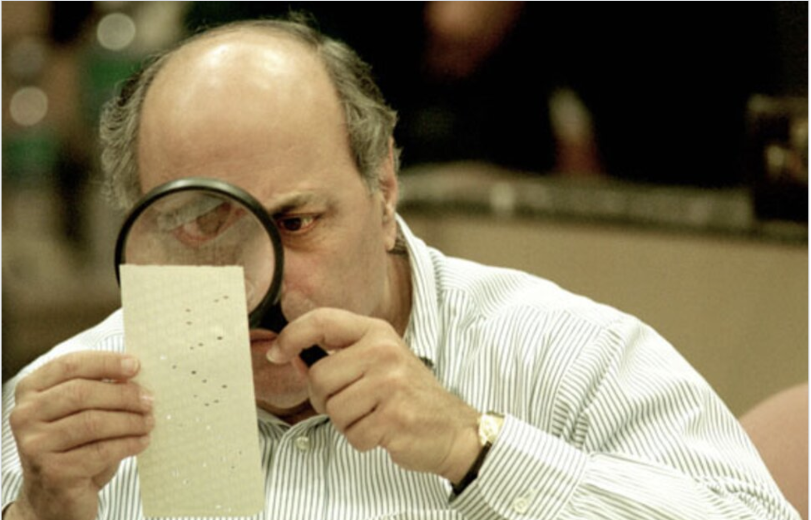
2000 Election – Bush vs Gore

Slide 16
2000 Election – Bush vs Gore
Election controversies
  Chads
  Conflicts of interest
  Florida’s election laws

Slide 17
2000 Election – Bush vs Gore
Chads
  Hanging chad
    Attached to the ballot at only on corner
  Swinging chad
    Attached to the ballot at two corners
  Pregnant chad
    Attached to the ballot at all four corners but bears an indentation indicating the voter may have intend to mark the ballot

Slide 18
2000 Election – Bush vs Gore
Chads
  Overvotes
    Ballots that recorded multiple votes for the same office
  Undervotes
    Ballots that recorded no vote for a given office

Slide 19
2000 Election – Bush vs Gore
Conflicts of interest
  Jeb Bush was governor
  Bob Butterworth, Florida’s Attorney General, headed Bush’s Florida Campaign
  Katherine Harris, Secretary of State, was co-chair of Bush’s Florida campaign

Slide 20
2000 Election – Bush vs Gore
Florida’s election laws
  Machine recount of all votes cast when the margin of victory was less then 0.5 percent.
  The gap in this race, appeared to be less than 0.01 percent
On election night, November 7, 2000, no clear winner in Florida
  Media initially projected Gore the winner
    Later declared Bush had opened an insurmountable lead
Based on this information Gore called Bush to concede the election*

Slide 21
2000 Election – Bush vs Gore
A machine count of the ballots was completed on November 10th
  Conflict arose between Florida’s Secretary of State and Florida Supreme Court*
  On December 8, in a 4–3 decision
    Florida Supreme Court ordered immediate manual recounts of undervotes for the office of president
    In all counties where such recounts had not already taken place.*
  Based on the U.S. Supreme Court’s ruling
    George W. Bush was elected the 43rd president of the United States

Slide 22
2000 Election – Bush vs Gore
Final vote totals nation wide
Candidate | Party | Electoral Votes | Popular Votes
George W. Bush | Republican | 271 | 50,456,002
Al Gore | Democratic | 266 | 50,999,897

Slide 23
1876 Election – Hayes vs Tilden
Why discuss this election
  Historians have deemed this election the most corrupt in the history of the United State
  Florida was the swing state for the election*
  Reconstruction was a big factor in the outcome of the election
    From 1867 when Congress passed the Reconstruction Act to 1877 when nearly 4 million formerly enslaved people were integrated into society*

Slide 24
1876 Election – Hayes vs Tilden
  The Republican Party needed this election to maintain national power
  Republicans controlled the White House from Abraham Lincoln’s first term in 1861 to Ulysses S. Grant’s second term ending in 1877*
  If Hayes wins the election, the Republican Party will continue in power until 1885 with James Garfield and Chester A. Arthur*
  Republicans also controlled both Houses of Congress until 1875

Slide 25
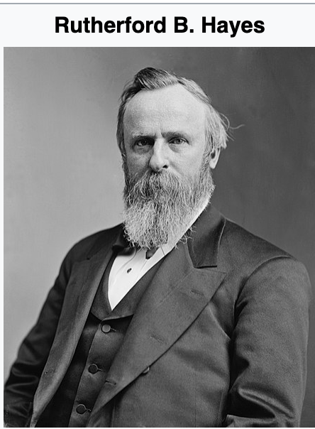
1876 Election – Hayes vs Tilden
b. October 4, 1822 d. January 17, 1893
President March 4, 1877 to March 4, 1881 55 years old when elected

Slide 26
1876 Election - Hayes vs Tilden
RUTHERFORD B. HAYES
  His American heritage can be traced back to the 1680’s New England
  In the early 1800’s Hayes’ family was struggling to make ends meet due to New England’s poor economy
    1817 his family moved to Delaware, Ohio*
  He had ambitions to become a lawyer*
    Decided to attend Harvard Law School
    Graduated in 1845 with a bachelor of laws degree

Slide 27
1876 Election - Hayes vs Tilden
RUTHERFORD B. HAYES
  After graduation he settled in Cincinnati and opened a law practice*
    His main source of income was defending runaway slaves who had fled across the Ohio River from Kentucky*
  While in Cincinnati he met his future wife Lucy Ware Webb*

Slide 28
1876 Election - Hayes vs Tilden
RUTHERFORD B. HAYES
  He served for the Union in the Civil War
    Was wounded three times during his service
    Retired from the Union Army at the end of the war with the rank of brevet Major General*
  His bravery and leadership helped his political career*

Slide 29
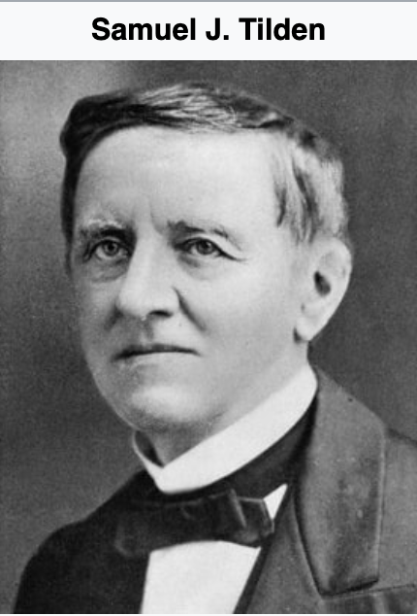
1876 Election – Hayes vs Tilden
b. February 9, 1814 d. August 4, 1886 62 years old at election day

Slide 30
1876 Election - Hayes vs Tilden
SAMUEL J. TILDEN
  His family descended from early English settlers who came to North America in 1634
  Tilden was born in New Lebanon, New York*
    Elam and Polly Jones Tilden had eight children*
    Very sickly as a child
    Was unable to attend school regularly*

Slide 31
1876 Election - Hayes vs Tilden
SAMUEL J. TILDEN
  At the age of 18, he moved to New York City*
    Tilden became interested in politics*
  At another attempt to complete his education he entered Yale University in June 1834
    He left after one term*
  He believed a law degree would help achieve his goals
    In 1838 Tilden entered the School of Law of the University of the City of New York*

Slide 32
1876 Election - Hayes vs Tilden
SAMUEL J. TILDEN
  Tilden prospered as a lawyer
    He became a key attorney representing New York City
    Fought corruption within the civil service system in NYC
    Advised railroad companies*
  He played a prominent role in the reorganization of the New York Democratic Party
    Serving as the Party Chairman of the State of New York*
  Tilden was elected governor of New York in 1874 as a champion of reform

Slide 33
1876 Election - Hayes vs Tilden
THE CAMPAIGN
  Early 1870s economic depression, political scandals, and the Panic of 1873
    Affected the popularity of the Republican Party*
      Even though Black voters overwhelmingly supported the Republican Party
    Democrats saw a path to electoral victory*
  White Southerners supported the Democratic Party*

Slide 34
1876 Election - Hayes vs Tilden
THE CAMPAIGN
  Ohio Governor Hayes ran on a reform platform*
    He was hampered by the Grant Administration’s scandals and poor economic management
  Hayes was well liked in the Republican Party*
  The Republican National Convention was held in Cincinnati, Ohio
    Very favorable for Hayes
    Hayes won the nomination on the fifth ballot

Slide 35
1876 Election - Hayes vs Tilden
THE CAMPAIGN
  New York Governor Tilden was known for challenging political corruption*
    He was an obvious choice and the front runner for the Democratic Party’s presidential nominee*
  Partial list of the Democratic platform
    Repeal the Specie Payment Resumption Act*
    Condemned the Grant Administration’s corruption
    Reaffirmed the Reconstruction Amendments*
    Civil service reform*

Slide 36
1876 Election - Hayes vs Tilden
THE CAMPAIGN
  At this time, Democrats controlled the House of Representatives
    Passed a statehood bill for Colorado*
  Now Tilden aggressively focused on winning the crucial New York state vote and its 35 electoral votes
  It was considered improper for a candidate to actively campaign for the presidency
    Neither candidate stumped as part of their campaign
    Was the duty of their surrogates

Slide 37
1876 Election - Hayes vs Tilden
THE CAMPAIGN
  A cutthroat campaign by both camps*
    Democrats attacked the corruption in Grant’s administration
    Republicans countered with attacks on the Democrats positions on the Civil War
  If votes had been counted accurately and fairly in Southern states, Hayes might have won the 1876 election outright

Slide 38
1876 Election - Hayes vs Tilden
ELECTION DAY – NOVEMBER 7, 1876
  Both parties participated in rampant fraud
    Republican operatives
      Stuffed ballot boxes
      Allowed repeat votes
      Threw out Democratic ballots
    Democrat operatives
      Violence against and intimidation of black voters in the Southern United States
      An attempt to keep them from the polling places

Slide 39
1876 Election - Hayes vs Tilden
ELECTION DAY – NOVEMBER 7, 1876
  On election night Hayes prepared his concession speech
    He was losing badly*
  Tilden was so confident he had won he went to bed early
  As the final votes came in
    It became evident in four states the results were not clear
    Both parties claimed victory without a final count*

Slide 40
1876 Election - Hayes vs Tilden
POST ELECTION
  The Republican National Party chair wired Republican officials in Florida, Louisiana, South Carolina, and Oregon to hold their states for Hayes
  In response, the Democratic National Party organized committees of prominent Democrats to travel South and oversee the vote counting*
  On December 6, 1876, the electors of the four contested states
    Met in their respective state capitals to cast their ballots*

Slide 41
1876 Election - Hayes vs Tilden
1877 ELECTORAL COMMISSION ACT
  The election was at a stalemate
  Since the Democrats controlled the House and the Republicans the Senate
    A variety of proposals where bitterly rejected by each side
  On January 29, 1877, a solution to the impasse was agreed upon
    The 1877 Electoral Commission Act*
    15 members formed the commission*
  After the commission members were selected
    The independent member of the Supreme Court resigned*

Slide 42
1876 Election - Hayes vs Tilden
1877 ELECTORAL COMMISSION ACT
  The Commission began hearing arguments on February 1,1877 in the U. S. Supreme Court chamber
  The first action by the Commission
    Florida’s electoral votes*
    After Florida award all 20 electoral votes to Hayes
      An informal, back-room deal*
  The Commission’s ruling was reported to Congress on February 23, 1877

Slide 43
1876 Election - Hayes vs Tilden
1877 ELECTORAL COMMISSION ACT
  Congress convened on March 1st to complete the tally of electoral votes
    Work was completed at 4 AM March 2nd
      Hayes was declared the winner
  Hayes was sworn in privately on March 3rd
    Inauguration Day was March 4,1877 which happened to be a Sunday
    The public swearing in took place on Monday, March 5th *

Slide 44
1876 Election - Hayes vs Tilden
TILDEN POST ELECTION
  Tilden continued to have a commanding position in the National Democratic Party
    In both 1880 and 1884 presidential elections, Tilden declined to run
    Both times due to health issues
  Tilden retired after the 1884 Democratic Convention*
  He continued to have bad health
    Died a bachelor on August 4, 1886*

Slide 45
United States Presidential Elections
1877 ELECTORAL COMMISSION ACT
  Historians believed there was an outside influencer hired to keep control over both political parties
    To this day, Historians have not determined his name
    He was ruthless, my way or suffer the consequences
    It was believed he commissioned an Italian composer for his theme
  During my research for this presentation, I found a YouTube clip of a man from the Old West with no name
    I assumed this was the man
    The clip shows what happens when someone got on his bad side

Slide 46
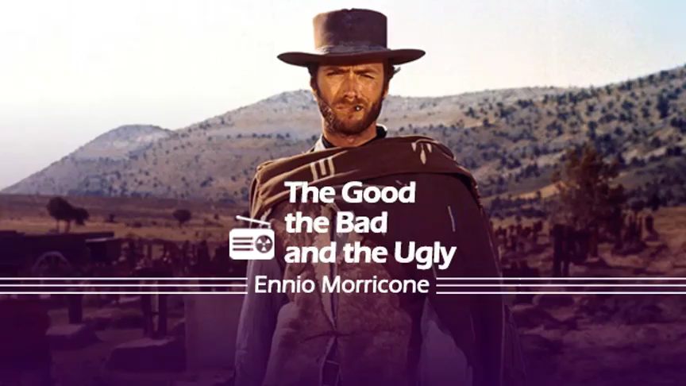
United States Presidential Elections

Slide 47
United States Presidential Elections
    THANK YOU

